Slide 1
Seminar:
Application of Genetic Algorithm for Computationally Demanding Problems
Zachary Hamida
George Saad, Fouad Azizi
June 14, 2017
American University of Beirut

Slide 2
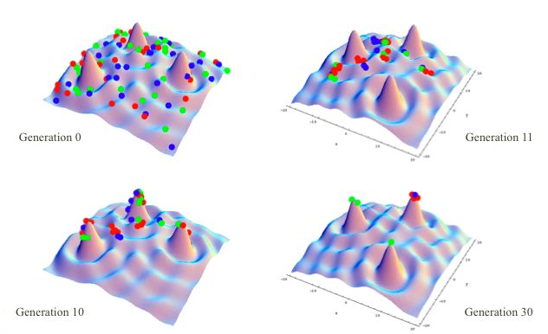
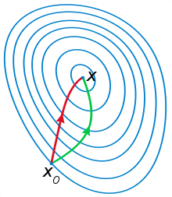
Background
Search Algorithm: try to find the input parameters corresponding to an optimal objective function value.
Two main branches:
Stochastic Search | Gradiant based Search
No Search Direction (try to look everywhere) | Specific path (Gradient and Hessian)
Population of Solution | Individual Solution (commonly)
Stopping Criteria (User defined) | Stopping Criteria (automatic)
i.e. Genetic Algorithm | i.e. Gradient Descent

Slide 3
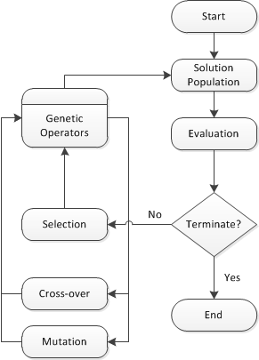
Introduction
Genetic Algorithm (GA)
Global non-gradient search algorithm (Holland, 1975)
Crossover
Mutation
Discrete
Min
1 | 1 | 1 | 1
Input (x1, x2, x3, x4)
5 | 8 | 12 | 20
Max
19 | 28 | 19 | 28
Location 1
Location 2
Notes:
Multiple inputs are evaluated in parallel at each step.
Input for the next step are generated by the “Operators”.
The Operators will generate inputs based on the previous step input evaluation.
The algorithm will keep iterating until meeting a stopping criteria.
Alpha fraction: is how much I’m willing to contribute to the next generation.
Continues

Slide 4
Introduction
Genetic Algorithm (GA)
Pros | Cons
Low computational cost (on the algorithm side) | Require a high number of iterations
Easy to implement | Premature Convergence
Good exploration properties | No Guarantee of convergence
For black box computationally heavy problems, the high number of iterations requirement is problematic
Notes:
Now, Since our focus is on field development, I want to introduce the major stages of Oil Recovery mechanisms throughout the lifetime of an oil field:
When first drilled, an oil well will produce based on natural fluids expansion. And the difference between the high pressure in the rock formation and the low pressure in the will result in an oil flow through the well.
This natural driving mechanism might be insufficient in terms of production rate or might not last for the entire production period of the reservoir, thus the Secondary recovery through (water or gas) flooding is introduced to get the production back on track. The concept is through drilling injection wells to drive the oil to the production well. Furthermore, a more costly procedure for the flooding is the EOR (..) whereby we inject more complicated liquids to drive the oil out. And the last resort for oil extraction is the infill recovery whereby we target a spot by drilling a production well.

Slide 5
Literature
Hybrid Genetic Algorithm (GA):

Slide 6
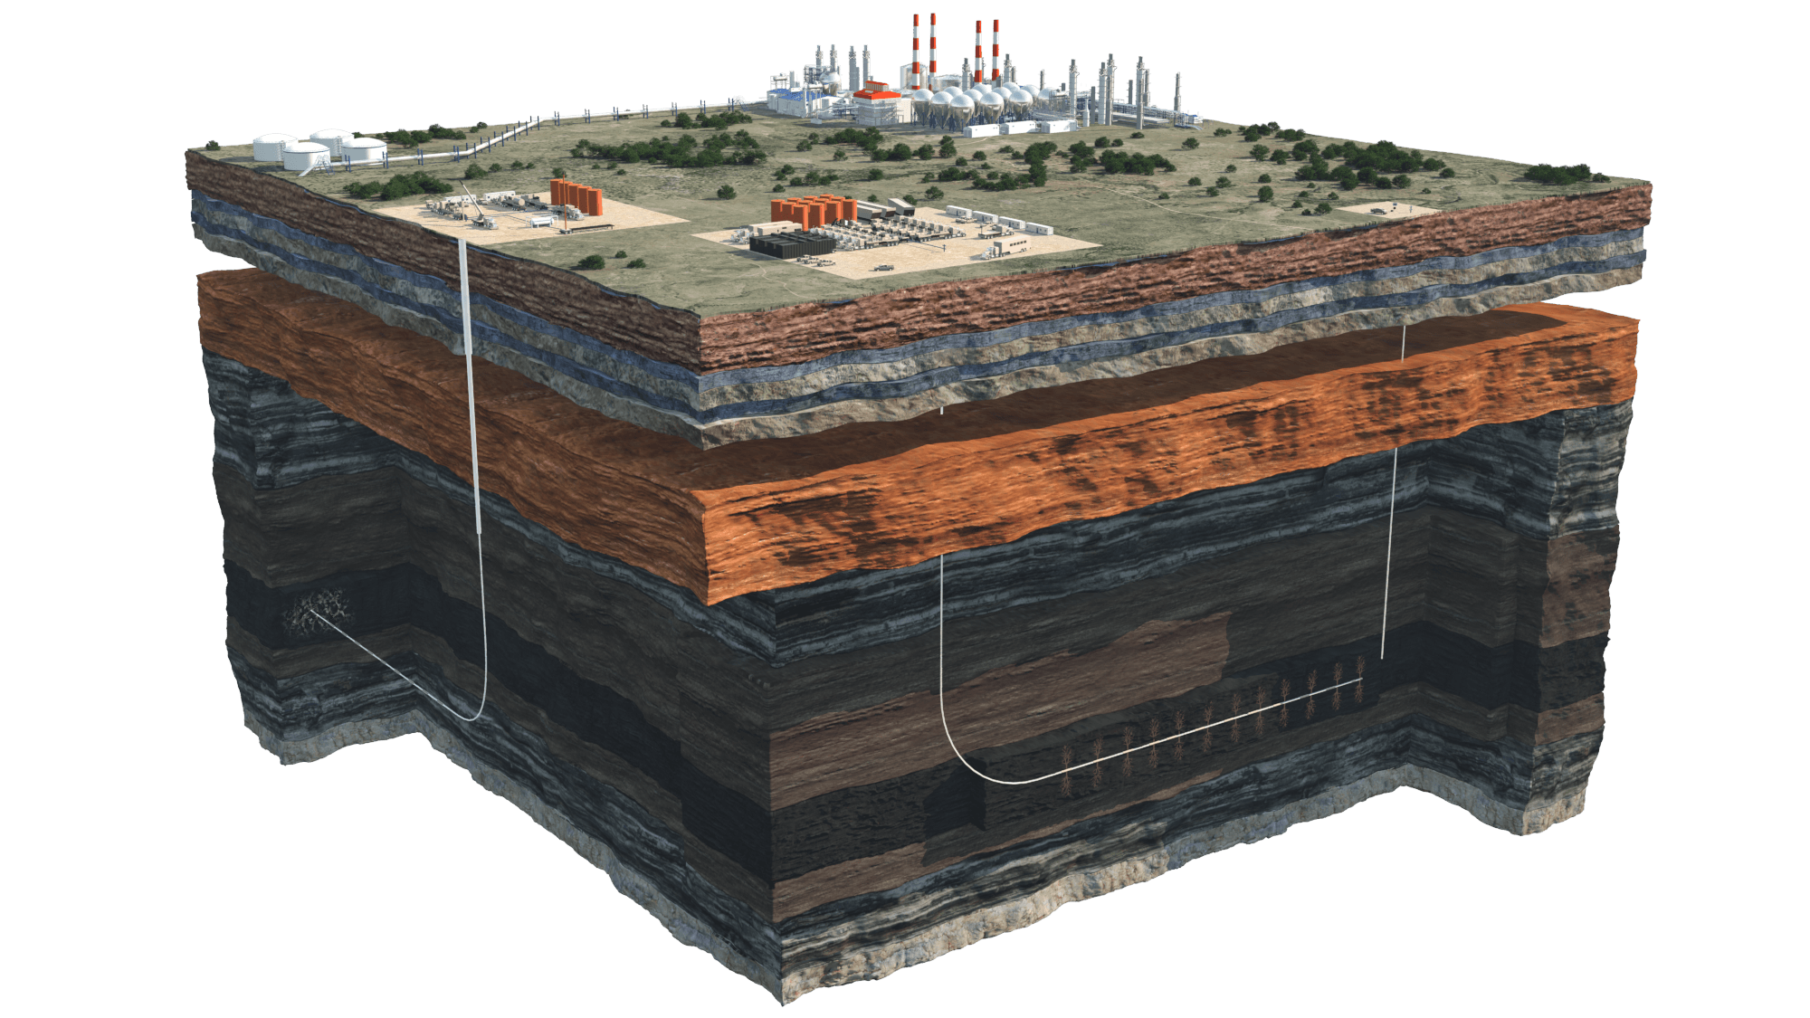
Example Problem
Oil Reservoir
Reservoir Engineering
Oil Field Development & Planning
(i.e. Well placement)
Notes:
I would like to quickly go over some of the definitions & terms in the topic,
first, what is a petroleum reservoir: is a subsurface pool of hydrocarbons contained in porous or fractured rock formations.
The field that is concerned with the design and evaluation of oil field development and exploitation processes. in other words, reservoir engineering is concerned with finding the oil and getting the most it.
As the part concerned with getting most of the oil comes: Oil field development: which is about finding strategies to extract the oil efficiently. And the efficiency here comes in terms of production rate (how fast) and sweep efficacy ( how much percentage of total volume can we extract)

Slide 7
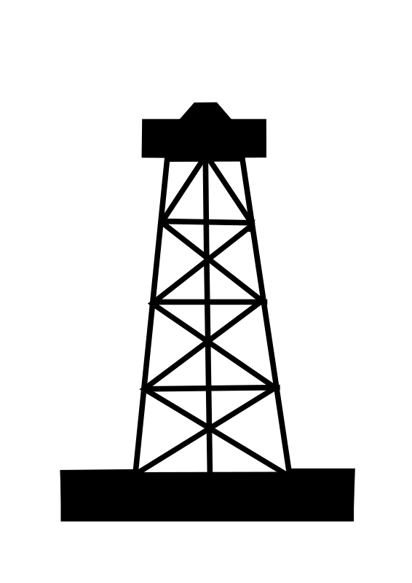
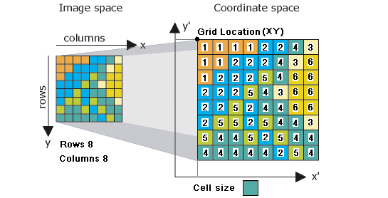
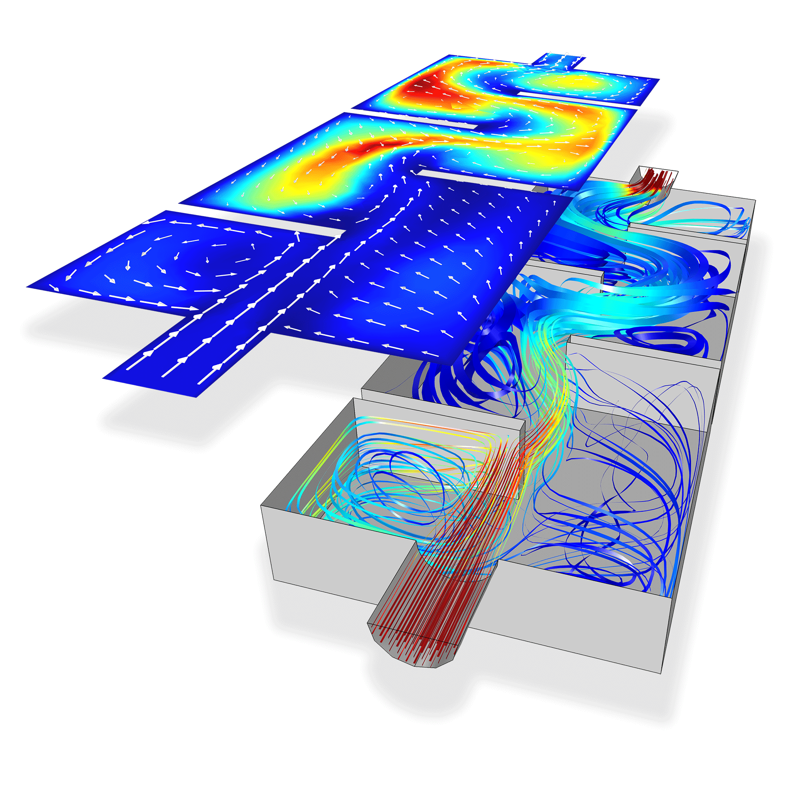
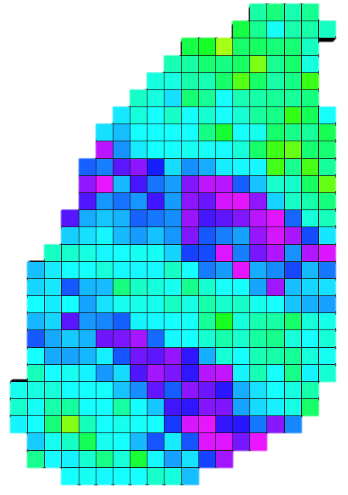
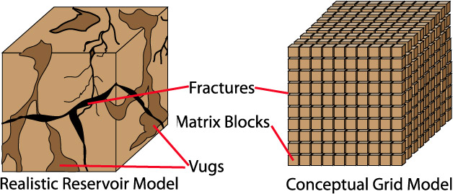
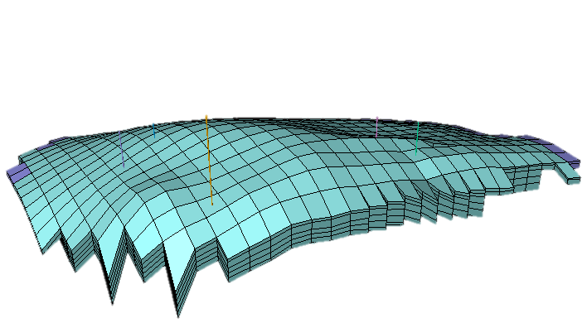
Example Problem
Reservoir Simulation Model
Numerical representation for field and wells data.
Provide a forecast for changes in the field.
+
+
Reservoir Model
Porosity
Permeability
Transmissibility
Pore volume
etc…
Notes:
The forecast can be provided through developing a reservoir simulation model.
The reservoir model main components are: a fluid model to describe fluids properties, a model for well properties and geological model describing soil properties.
For the geological model
The geological model has gained the most attention due to a lot of issues in the modeling process, These issues are summarized in the fact that the measurements are hard to obtain, given the size and depth of the reservoir.
However, for the data

Slide 8
Example Problem
Field Planning Problem:
Locations of wells to be drilled.
Time Sequence of drilling.
Wells production tuning (i.e. flow rates, bottom hole pressure… etc.)
Adjust Parameters
Oil Recovery
Vs.
Cost
Max Profit
Forecast fluid flow in the reservoir
Notes:
for the aforementioned recovery techniques to be efficient enough in economic terms, locating and deciding on the number of operating wells (injection or production) is a major concern.
This is due to the high cost of drilling as well as the impact on recovery efficiency.
furthermore, other factors can be studied as well like (flow rates of wells) but they don’t have as much of an impact for the overall process.
In abstract terms, the problem can be thought of as tuning (or changing) parameters to get the most possible profit. And to do so we need a forecast for oil production after each change.

Slide 9
(x,y)?
Pre-located wells

Slide 10
HGA Illustration
Mathematical Proxy
Reservoir Model
Mathematical Proxy
Notes:
At the begining we have a poor representation for the response surface

Slide 11

Motivation
Search Space for Optimal Location of One Well
Pre-located wells

Slide 12
Methodology
Objectives:
Account for field geological and geometrical properties when proposing solutions at each iteration.
Account for the well formation in the reservoir

Slide 13
Methodology
Genetic Similarity Algorithm
(GSA)
Notes:
Innovative new algorithm called GSA
In GSA
no premature convergence
Adaptive search, the algorithm will become better and better after each iteration.

Slide 14
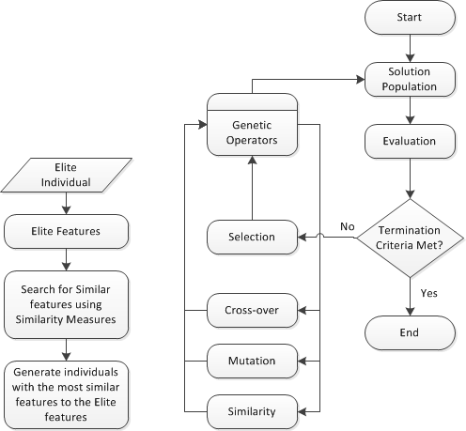
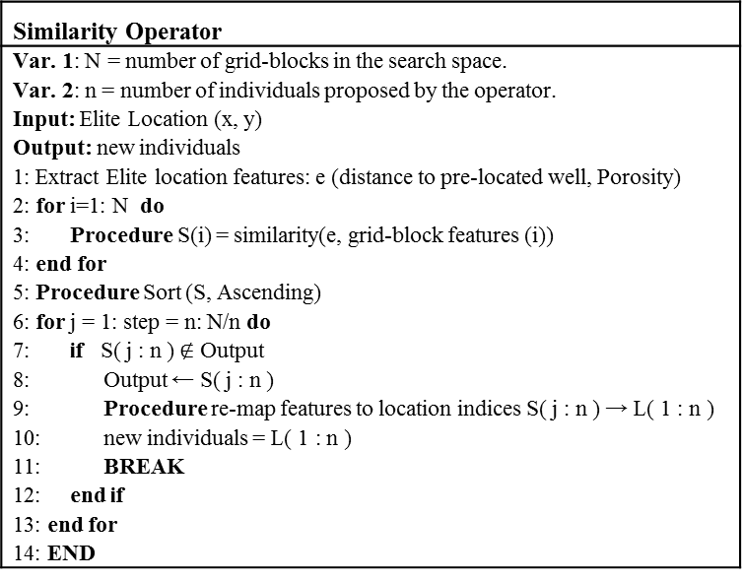
Methodology
Similarity Operator
Var. 1: N = number of grid-blocks in the search space. Var. 2: n = number of individuals proposed by the operator. Input: Elite Location (x, y) Output: new individuals 1: Extract Elite location features: e (distance to pre-located well, Porosity) 2: for i=1: N do 3: Procedure S(i) = similarity(e, grid-block features (i)) 4: end for 5: Procedure Sort (S, Ascending) 6: for j = 1: step = n: N/n do 7: if S( j : n ) $∉$ Output 8: Output ← S( j : n ) 9: Procedure re-map features to location indices S( j : n ) → L( 1 : n ) 10: new individuals = L( 1 : n ) 11: BREAK 12: end if 13: end for 14: END
Figure 2: (a) Similarity Operator Flow chart; (b) Genetic Similarity Algorithm

Slide 15
Methodology

Slide 16
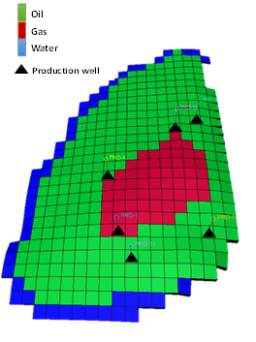
Reservoir Models
PUNQ-S3:
The model size is 19x28x5 (1761 active cells)
Oil, Gas, and Water
6 Initial Production Wells
PUNQ-S3 Oil Field Model

Slide 17
Results
Single Well Placement Problem
Assess the convergence rate
 | Genetic Algorithm
 | GA-A1 | GA-A2 | GA-A3 | GA-A4 | GA-B1 | GA-B2 | GA-B3 | GA-B4
Pop. Size | 10 | 10 | 10 | 10 | 20 | 20 | 20 | 20
Elite | 10% | 10% | 20% | 20% | 5% | 5% | 10% | 10%
Crossover | 70% | 50% | 60% | 50% | 75% | 55% | 70% | 55%
Mutation | 20% | 40% | 20% | 30% | 20% | 40% | 20% | 35%
Surrogate Model
ANN
# Layers | 2
# Hidden Neurons | 20,20
SVM Regression
Kernel Type | RBF
Genetic Similarity Algorithm
Pop. Size | 10 | 10 | 10 | 10 | 10 | 10 | 20 | 20 | 20 | 20 | 20 | 20
Elite | 10% | 10% | 10% | 10% | 10% | 10% | 5% | 5% | 5% | 5% | 5% | 5%
Crossover | 60% | 50% | 40% | 30% | 20% | 10% | 65% | 55% | 45% | 35% | 25% | 15%
Mutation | 20% | 20% | 20% | 20% | 20% | 20% | 20% | 20% | 20% | 20% | 20% | 20%
Similarity | 10% | 20% | 30% | 40% | 50% | 60% | 10% | 20% | 30% | 40% | 50% | 60%
Case Label | GSA-A1 | GSA-A2 | GSA-A3 | GSA-A4 | GSA-A5 | GSA-A6 | GSA-B1 | GSA-B2 | GSA-B3 | GSA-B4 | GSA-B5 | GSA-B6
Experiment Setup
22.5 + 6 years
Notes:
We varied the proportion of each genetic operator

Slide 18
Results
The single well placement problem was solved 100 times by each algorithm to assess the consistency of the algorithms performance
 | Population Size = 10
 | GA-A1 | GA-A2 | GA-A3 | GA-A4 | HGA I | HGA II
µ | 167.7 | 175.2 | 166 | 173.5 | 188.9 | 178.2
σ | 192.6 | 166.2 | 202.13 | 204 | 169.1 | 146.2
% | 88 | 96 | 82 | 90 | 99 | 100
 | GSA-A1 | GSA-A2 | GSA-A3 | GSA-A4 | GSA-A5 | GSA-A6
µ | 130.8 | 123.5 | 127.4 | 132.5 | 112.8 | 107.8
σ | 83.4 | 68.5 | 71 | 72.6 | 54.2 | 49.8
% | 100 | 100 | 100 | 100 | 100 | 100
 | Population Size = 20
 | GA-B1 | GA-B2 | GA-B3 | GA-B4 | HGA I | HGA II
µ | 182.7 | 192.6 | 210.6 | 179.2 | 219.7 | 186.3
σ | 135 | 87 | 220.97 | 89.62 | 144.8 | 111
% | 96 | 100 | 93 | 100 | 100 | 100
 | GSA-B1 | GSA-B2 | GSA-B3 | GSA-B4 | GSA-B5 | GSA-B6
µ | 177.3 | 162.5 | 145.5 | 144.4 | 127 | 128.7
σ | 86.1 | 85 | 69.6 | 66.3 | 56.7 | 51.3
% | 100 | 100 | 100 | 100 | 100 | 100
PUNQ-S3 Single Injection Well Allocation Response Surface

Slide 19
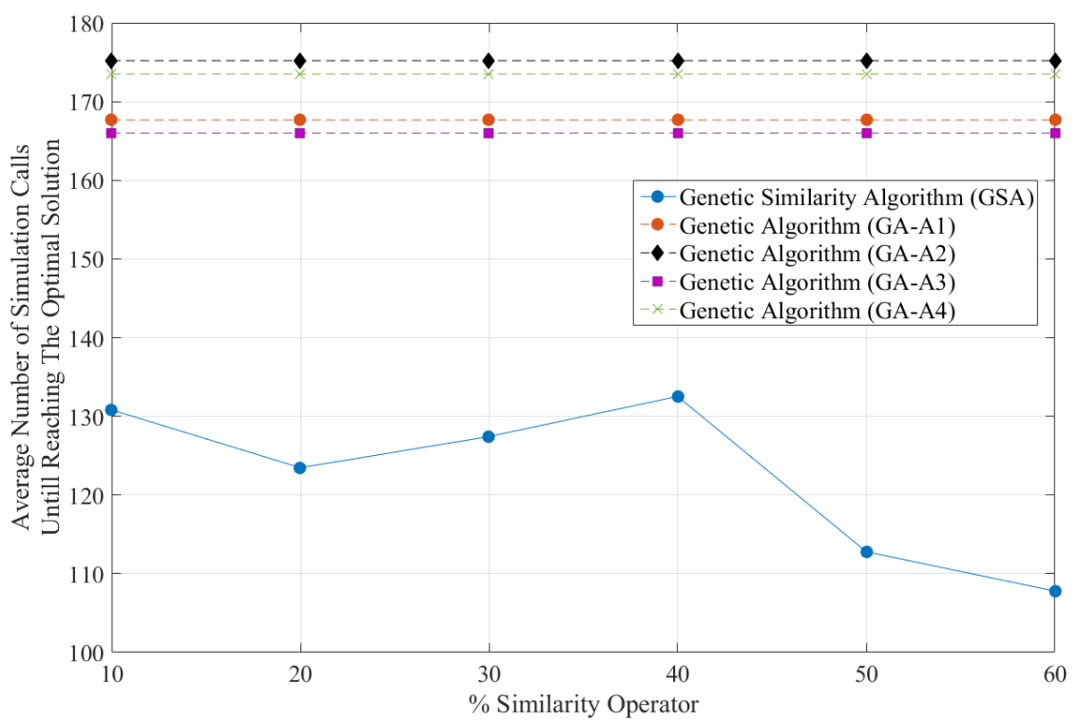
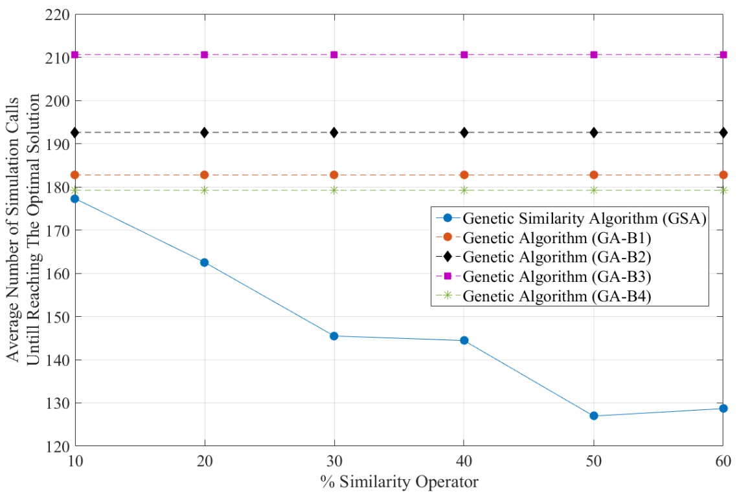
Results
Genetic Algorithm vs. Genetic Similarity Algorithm with different fractions of Similarity Operator for Pop. Size = 10
Genetic Algorithm vs. Genetic Similarity Algorithm with different fractions of Similarity Operator for Pop. Size = 20

Slide 20
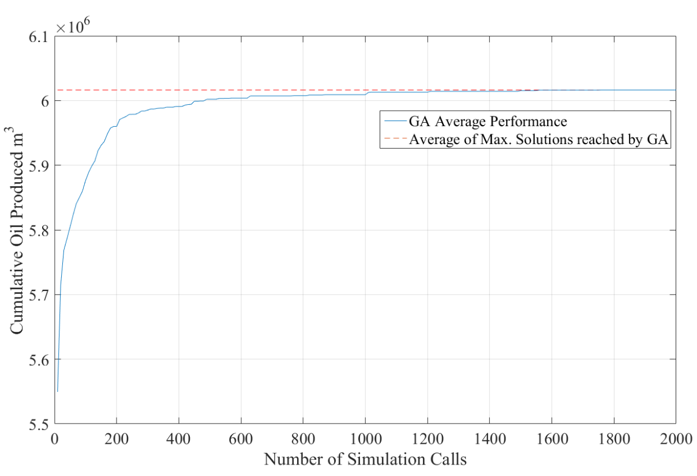
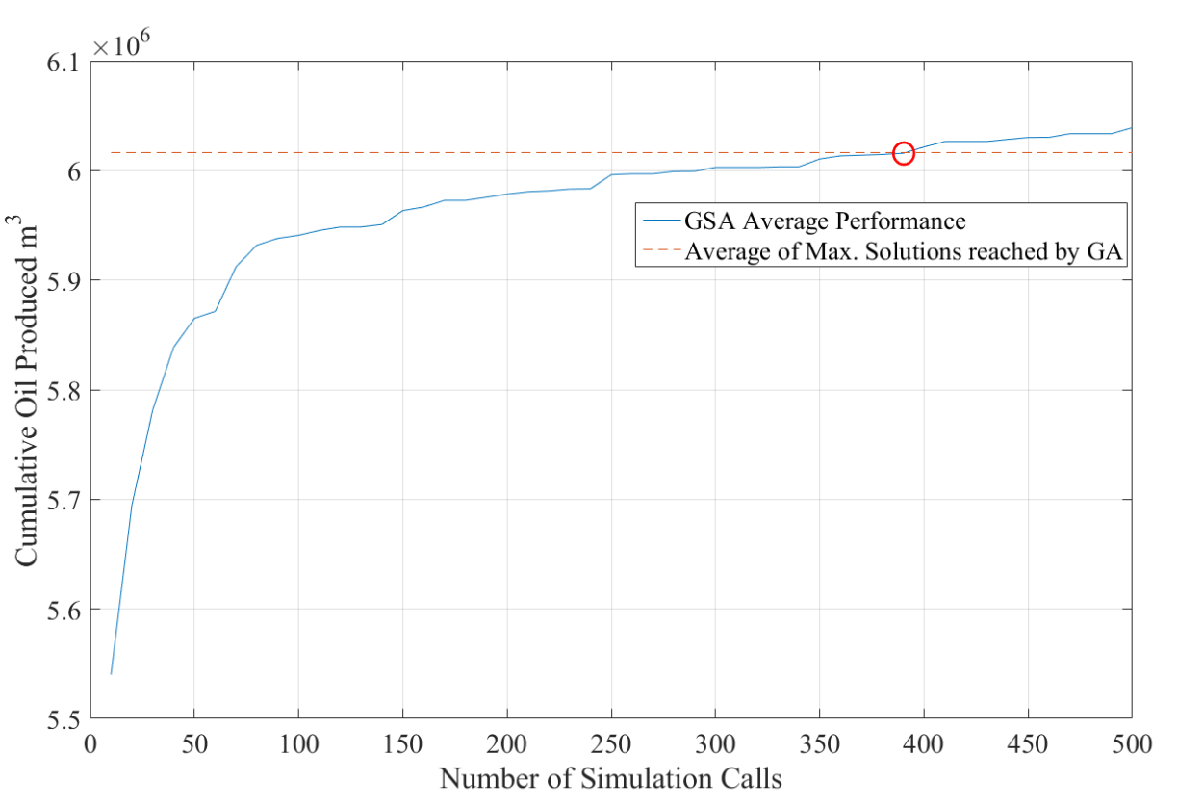
Results
Muti-Well Placement Problem
Assess the convergence rate
3 Production Wells
 | Genetic Algorithm | Genetic Similarity Algorithm
Pop. Size | 10 | 10
Elite | 10% | 10%
Crossover | 70% | 40%
Mutation | 20% | 20%
Similarity | - | 30%
GA average performance over 10 optimization runs for optimal well placement of 3 production wells in PUNQ-S3 model
GSA algorithm average performance over 10 optimization runs for optimal well placement of 3 production wells in PUNQ-S3 model compared with the average of max solutions reached by GA
 | Average (m³) | Std. | Max. (m³) | Min. (m³)
GSA | 6.059 x 10⁶ | 15,640 | 6.074 x 10⁶ | 6.032 x 10⁶
GA | 6.016 x 10⁶ | 34,231 | 6.069 x 10⁶ | 5.959 x 10⁶

Slide 21
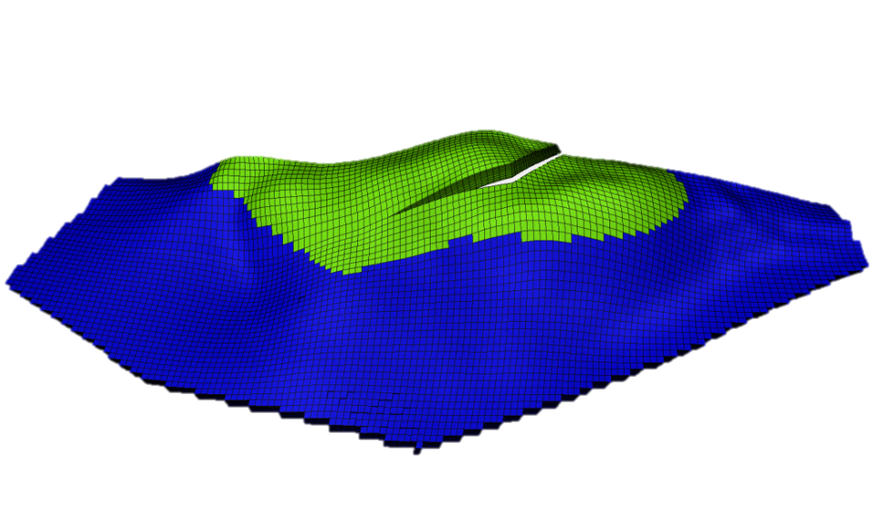
Results
Brugge Oil Field Model
Brugge Oil Field:
The model size is 139x48x9
Oil and Water

Slide 22
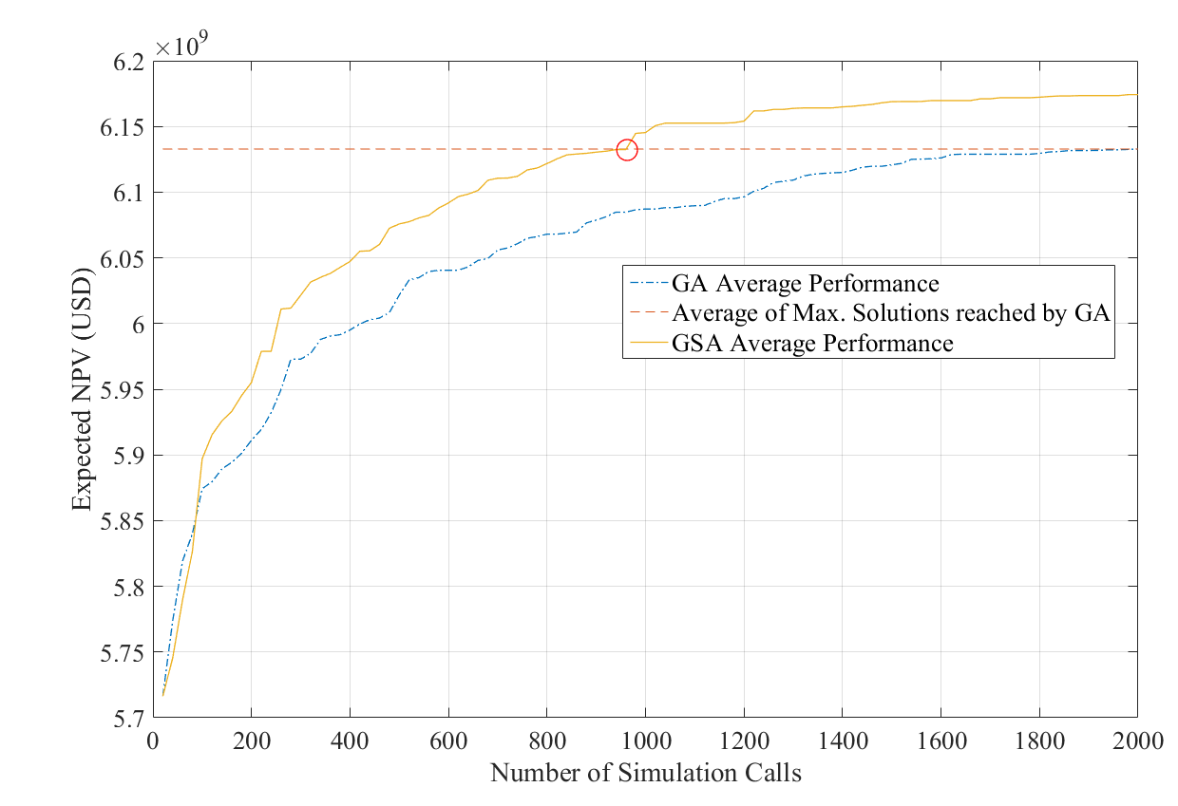
Results
 | Genetic Algorithm | Genetic Similarity Algorithm
Pop. Size | 20 | 20
Elite | 5% | 5%
Crossover | 75% | 45%
Mutation | 20% | 20%
Similarity | - | 30%
GSA and GA algorithms average performance over 10 optimization runs for optimal well placement of 5 injection wells in Brugge model
 | Average (USD) | Std. | Max. (USD) | Min. (USD)
GSA | 6.174 x 10⁹ | 1.467 x 10⁷ | 6.197 x 10⁹ | 6.151 x 10⁹
GA | 6.133 x 10⁹ | 2.928 x 10⁷ | 6.188 x 10⁹ | 6.094 x 10⁹

Slide 23
Conclusions
Conclusions
In this study, a novel genetic operator within GA is introduced to design a problem-specific search algorithm named Genetic Similarity Algorithm (GSA).
GSA performance validation (Convergence rate and solution robustness)
Finding an optimal location for single well (PUNQ-S3)
Finding an optimal location for Multiple wells at the same time (Brugge and PUNQ-S3)
When the Similarity Operator contribution to the population increased the performance of the algorithm was likely to improve

Slide 24
Thank You!

